Slide 1

Bring Your Helm Chart to the Wonderful World
Mansun Kuo
2024-10-23

Slide 2
Outline
Introduction
Exercises
11 Tips of Helm
References

Slide 3
Introduction

Slide 4
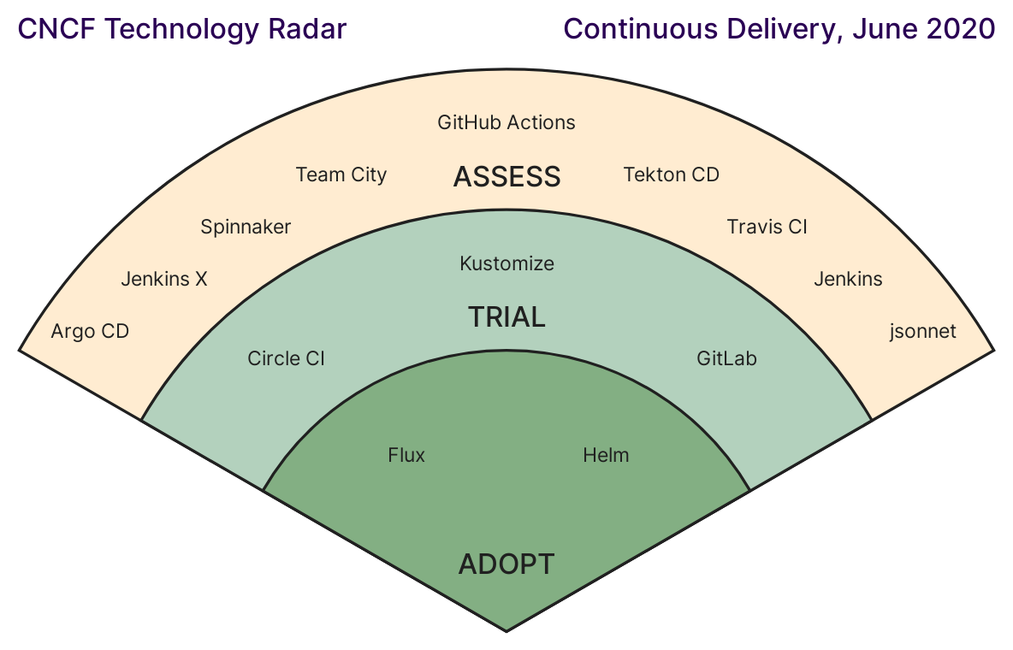
What is Helm
A handy tool that help you manage your applications on k8s
Declarative
Helm template language (based on Go template)
Variable, flow control, pipeline, …
Manage complexity
Simple sharing
Rollback to any revision
Adopted in CNCF technology radar, June 2020
https://radar.cncf.io/2020-06-continuous-delivery.png

Slide 5
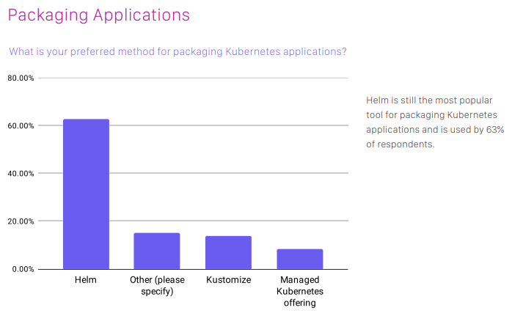
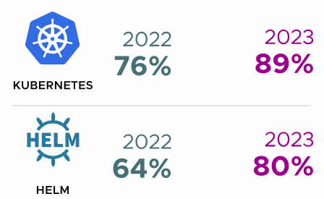
Alternative of Helm
Helm is the most popular way to packaging applications on k8s
Some other common approaches
Kustomize
Pure kubectl cli with envsubst
Custom scripts with template
https://www.cncf.io/wp-content/uploads/2020/11/CNCF_Survey_Report_2020.pdf
https://www.cncf.io/reports/cncf-annual-survey-2023/

Slide 6
Three Key Concepts
Helm install charts into Kubernetes, creating a new release for each installation. You can search Helm chart repositories to find new charts.
Chart
A helm package contains all of the resource definitions necessary to run an application, tool, or service inside of a Kubernetes cluster.
The Kubernetes equivalent of a Python package, apt, dpkg, or a Yum RPM file
Repository
The place where charts can be collected and shared
Like Python’s Pypi or the Fedora Package Database
Release
An instance of a chart running in a Kubernetes cluster

Slide 7
Basic Commands
helm search [command]
Find charts
helm repo [command]
Add a repository
helm install [NAME] [CHART] [flags]
Install a Helm chart
helm upgrade [RELEASE] [CHART] [flags]
Upgrade (or install) a Helm chart
helm upgrade --install
helm list [flags]
List all releases for a specific namespace
helm uninstall [RELEASE_NAME] [...] [flags]
Uninstall a helm chart

Slide 8
Exercises

Slide 9
Exercise 1: Create Your First Helm Char
Tutorial
English
繁體中文
GitHub

Slide 10
Exercise 2: Modify It as an API
Tutorial
English
繁體中文
GitHub

Slide 11
Exercise 3: Why My Secret Is Not Updated
Tutorial
English
繁體中文
GitHub

Slide 12
Exercise 4: Add a Helm Dependency
Tutorial
English
繁體中文
GitHub

Slide 13
Exercise 5: Chart Releaser Action
Tutorial
English
繁體中文
GitHub
Add your chart here

Slide 14
11 Tips of Helm

Slide 15
1. Get Help and Current Version
helm -h
Get all available command
helm [command] -h
Get help of a sub command
helm version
Get version

Slide 16
2. Use Helm Template to Check Values
Customizing values
--values: Specify a YAML file with overrides
--set: Specify overrides on the command line
helm template [NAME] [CHART] [flags]
Render chart templates locally and display the output

Slide 17
3. Create your own chart with helm create
helm create NAME [flags]
Create your own chart directory with the common files and directories used in a chart
More about chart development
Chart Development tip and Tricks
Built-in Objects
Template Functions and Pipelines
Template Function List
Flow Control
Variables
Named Templates

Slide 18
4. Use “partial” and Template Includes
In the templates/ directory, any file that begins with an underscore(_) is not expected to output a Kubernetes manifest file.
By convention, helper templates and partials are placed in a __helpers.tpl file.

Slide 19
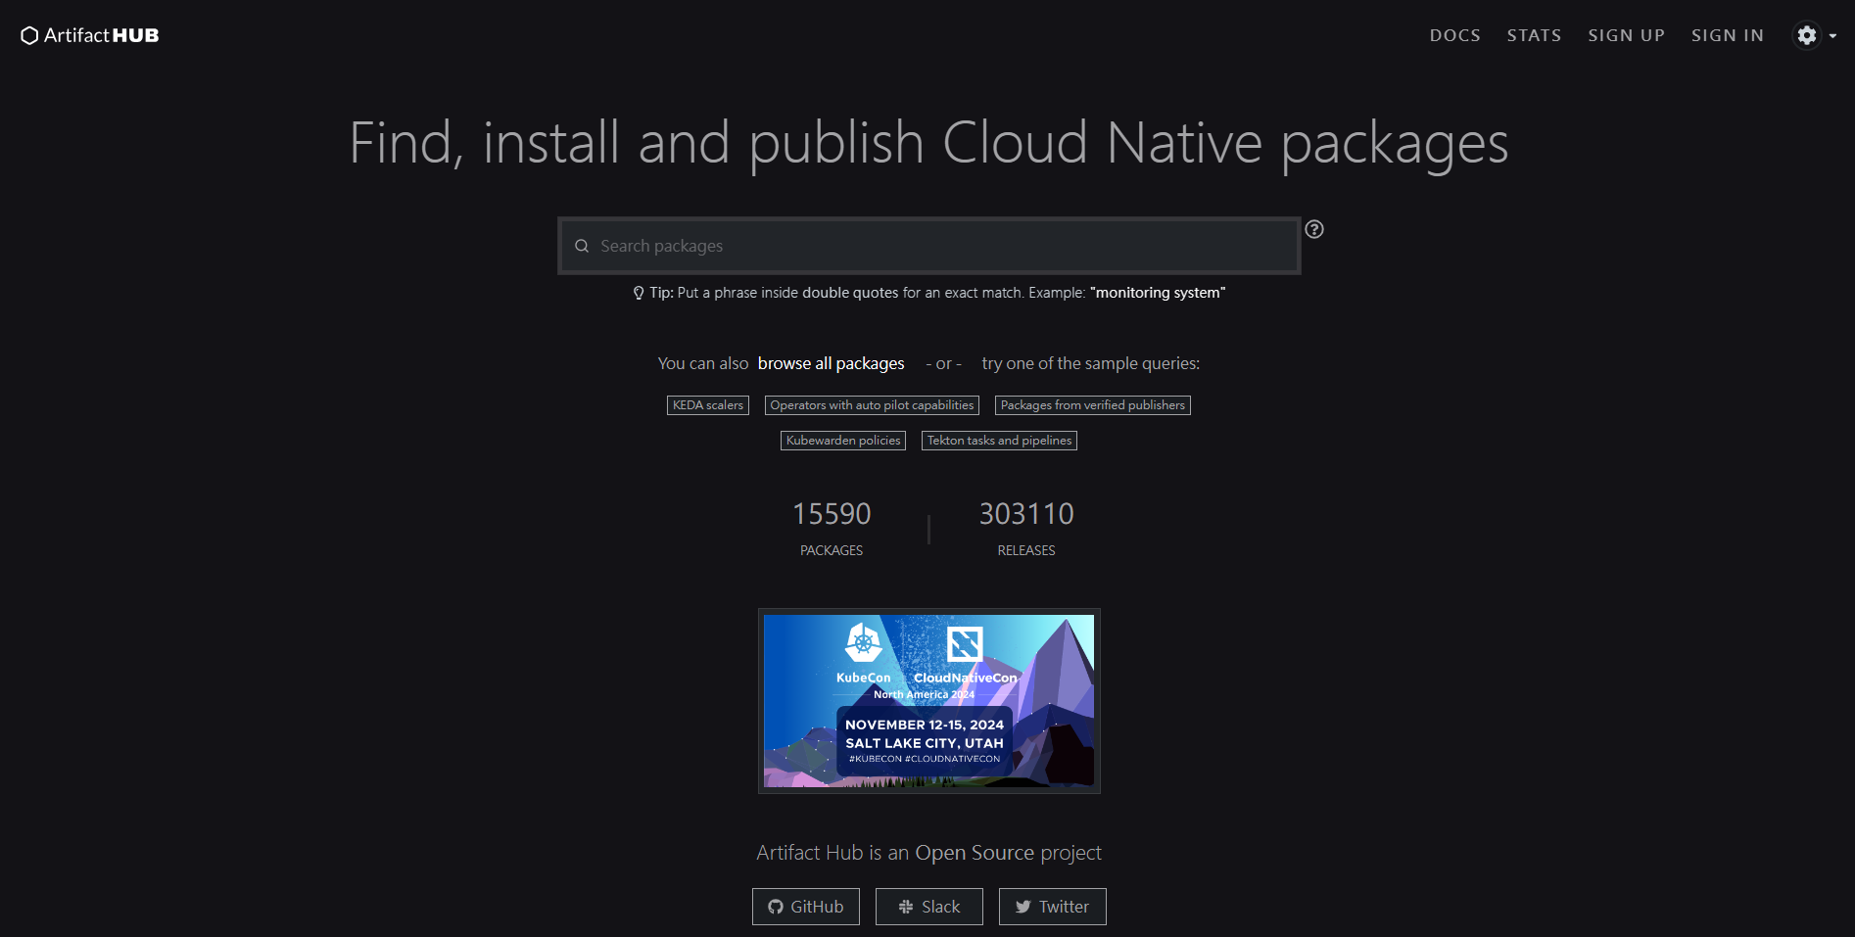
5. Find Packages on ArtifactHUB
Artifact Hub
An open-source project to discover, install and publish packages and configurations
https://artifacthub.io/

Slide 20
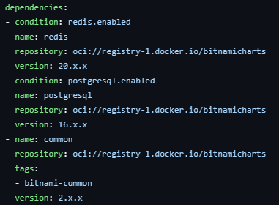
6. Use Helm dependency
You can add other packages with specific version into your chart with helm dependency
You can also overriding values from a parent chart.
https://github.com/bitnami/charts/blob/main/bitnami/airflow/Chart.yaml#L22-L35

Slide 21
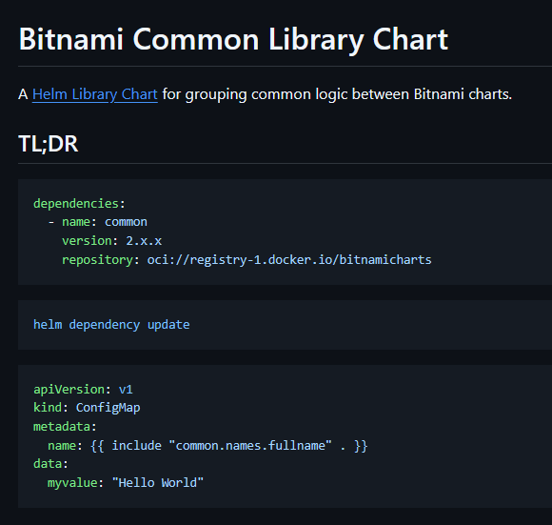
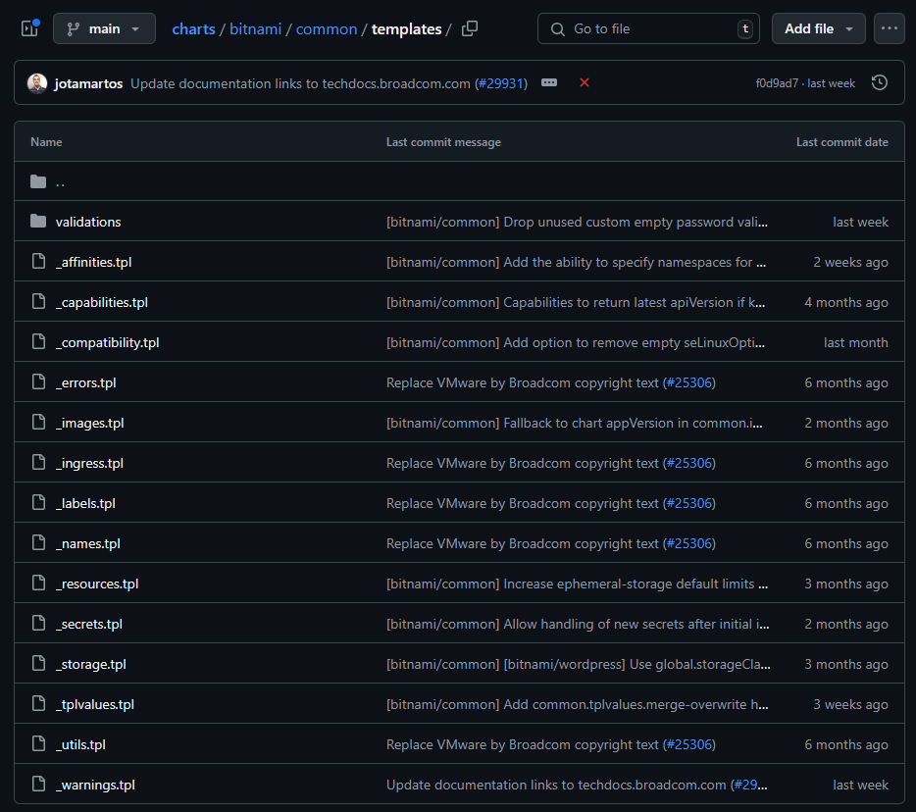
7. Use common logic in bitnami/common
https://github.com/bitnami/charts/tree/master/bitnami/common
https://github.com/bitnami/charts/tree/master/bitnami/common/templates

Slide 22
8. Use Helm Plugin
A Helm plugin is a tool that can be accessed through the helm CLI, but which is not part of the built-in Helm codebase.
The core of a plugin is a simple YAML file named plugin.yaml
helm-secrets
Decrypt secrets with Secret Backends
sops
vals
Hashicort Vault
AWS Secrets Manager
GCP Secrets Manager
Azure Key Vault
…

Slide 23
9. Commit Your Charts into Git
Treat git repository as the single source of truth of your infrastructure
Never store secrets in plain text in git
GItOps
A git repository with versioned CI/CD on top of declarative infrastructure
Deploy a new revision with updating the repository and the automated process handles everything else

Slide 24
10. Share Your Chart
Install sources:
A chart repository
A local chart archive
An uppacked chart directory
A full URL
Share
Git repository
Mount to other project with git submodule
Chart repository
An HTTP server that contains an index.yaml and optionally some packaged charts
Registry
Use an Docker registry with Helm registries

Slide 25
11. Have a better Developer Experience
IDE
Visual Studio Code
Kubernetes: Syntax highlight & UI
Helm Intellisense: Intellisense for helm templates
Autocomplete
helm completion

Slide 26
References

Slide 27
References
Kubernetes Summit 2024 - Workshop
Bring Your Helm Chart to the Wonderful World

Slide 28
Thanks

